Slide 1


EDA Students at Universities in Saudi Arabia 2013-2018
Presented by: Sahar Abdullah Al-Harthi

Slide 2
Problem statement
In the framework of working to achieve Vision 2030, the Ministry of Human Resources wishes to employ newly graduated students from universities in the Kingdom of Saudi Arabia to fill jobs available in the country. Knowledge of preparing students in the most important disciplines. The Department of Data Scientists was asked to conduct a study on the data of students graduating in universities, including all disciplines at the university. And preparing a report on the results in order to develop a cooperation strategy with the Ministry of Education to keep pace with the development in new disciplines at the world level and to provide human cadres in the newly created jobs

Slide 3

Problem statement

Slide 4
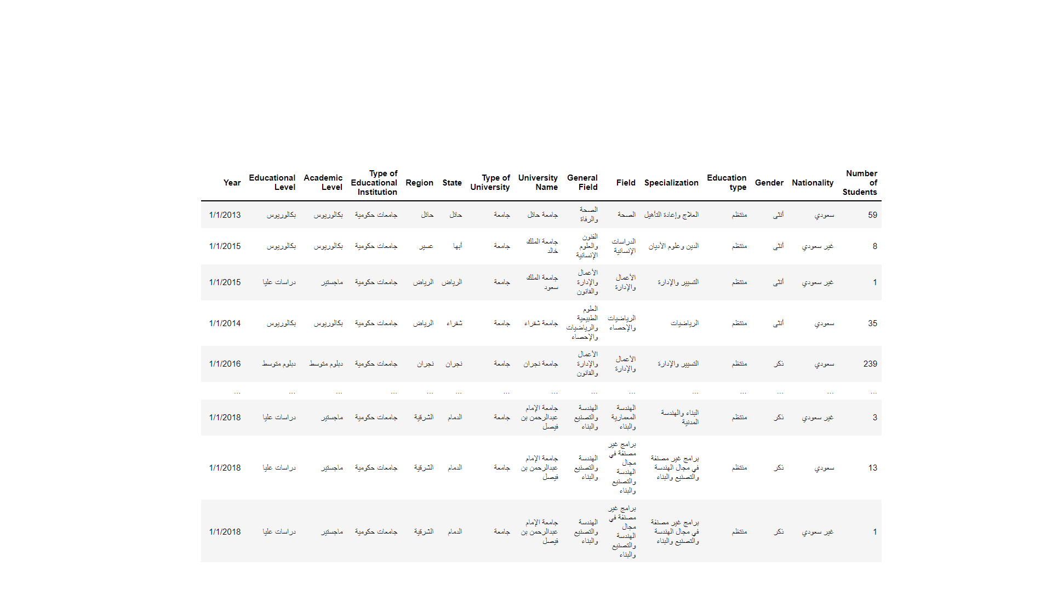
Dataset Description
The data set is about number of enrolled university students by field of study in Saudi Arabia 2013-2018 The dataset provided by Saudi open data Type of data (TEXT, INT) Size of data (15*67983) Rows (67983) Columns (15)
website: http:// data.gov.sa/ar

Slide 5
Dataset Description
Description | Feature
Academic stage in general | Educational Level
Academic stage in detail | Academic Level
Ownership of the educational institution | Type of Educational Institution
The area that oversees the university | Region
Classification of educational institution | Type of University
University Name | University Name

Slide 6
Dataset Description
Description | Feature
The city where the university is located. | State
The name of the college | General Field
University department name | Field
Name of university specialization | Specialization
The way you teach | Education type
Gender of student | Gender

Slide 7
Dataset Description
Description | Feature
Nationality of student | Nationality
Number of Students | Number of Students
School year | Year
The data set is about number of enrolled university students by field of study in Saudi Arabia 2013-2018 The dataset provided by Saudi open data Type of data (TEXT, INT) Size of data (15*67983) Rows (67983) Columns (15)
Name columns used (Year, number of students, Region, University Name, field, Specialization, gender, Academic level, Nationality, Education type, type of educational institution) Name columns do not need (Educational level, type of university, state, general field)

Slide 8
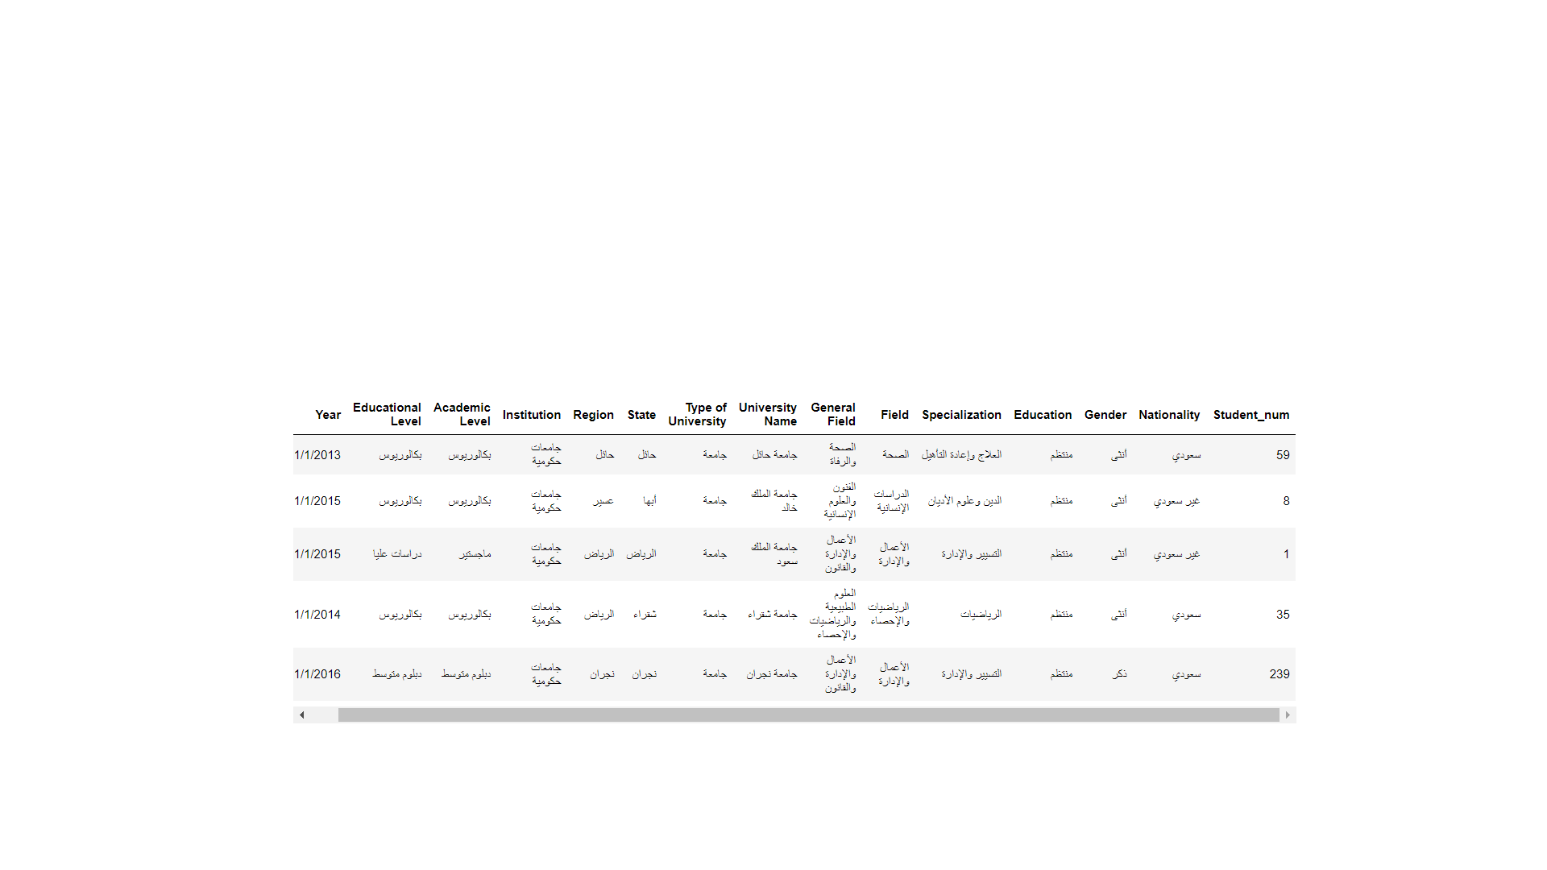
Clean Data
After reading Data then check missing values, and outliers :
1- No missing values
2- Delete outlier in one row
3- Drop 4 columns we didn’t need it at all.
4- Rename 4 columns

Slide 9
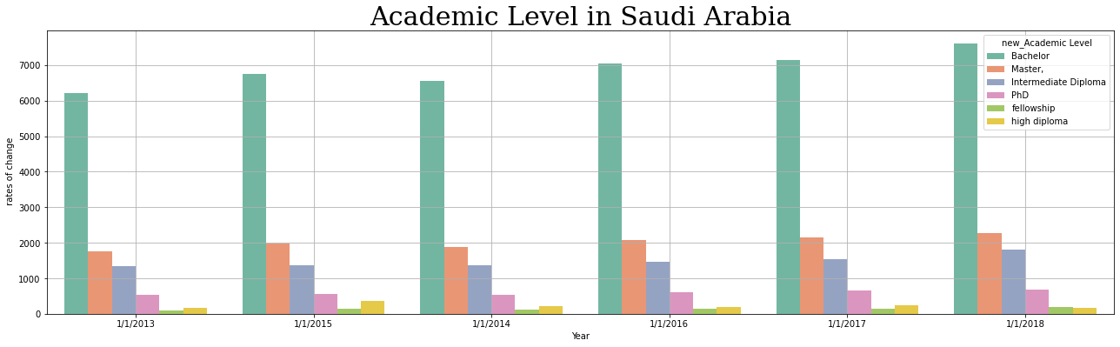
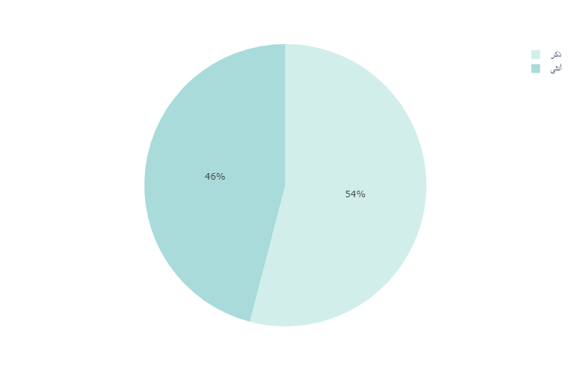
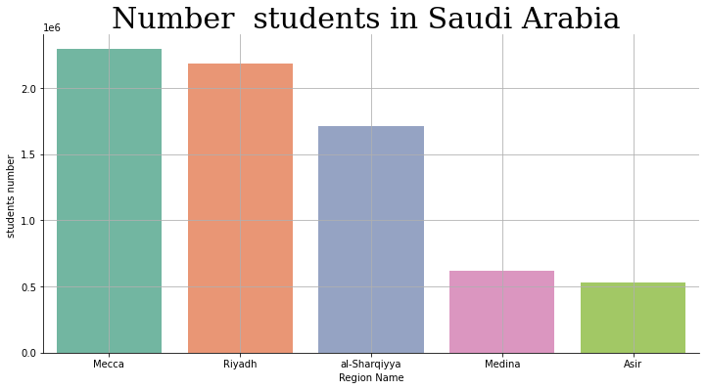
Results

Slide 10
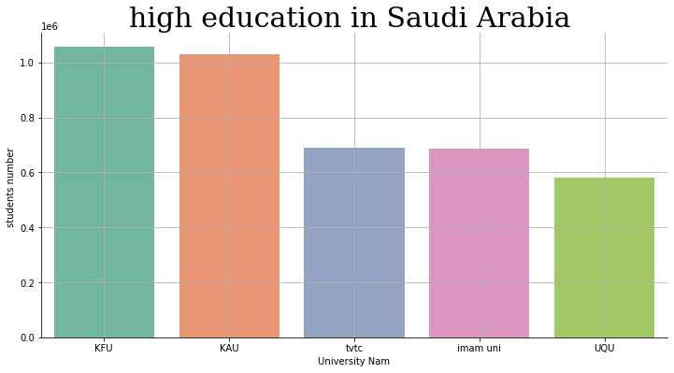
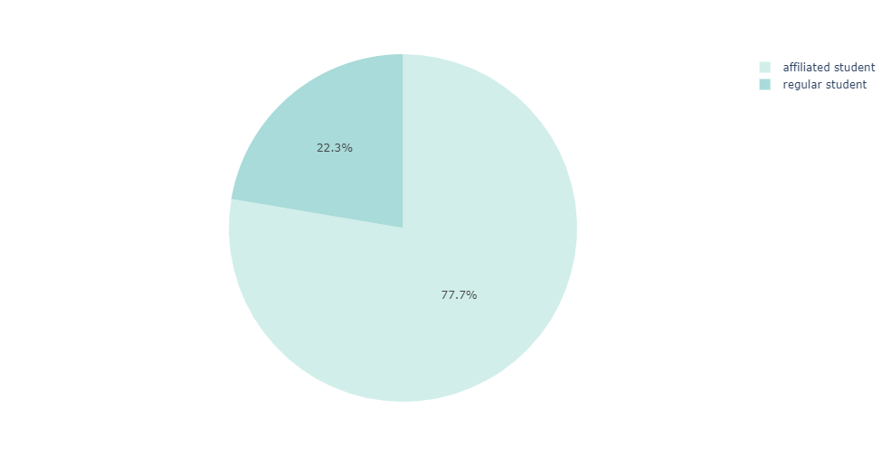

Slide 11
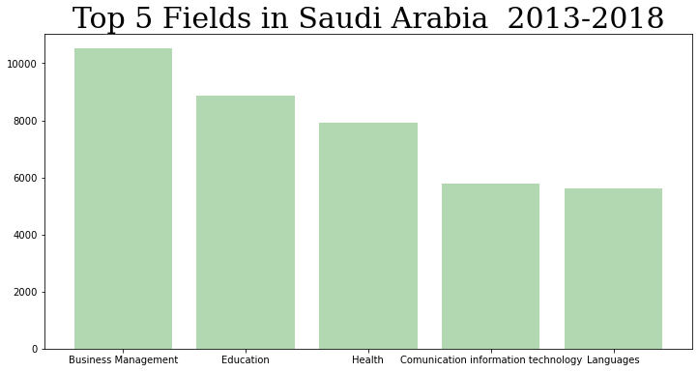
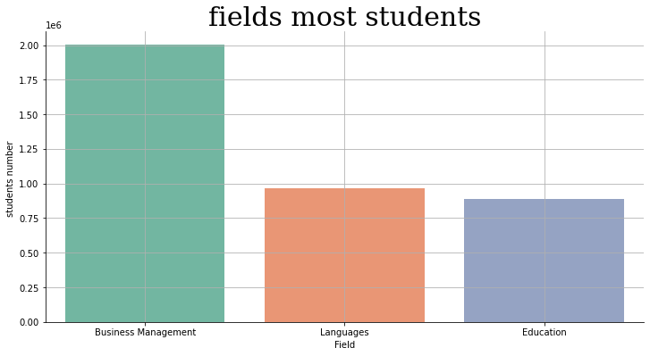

Slide 12
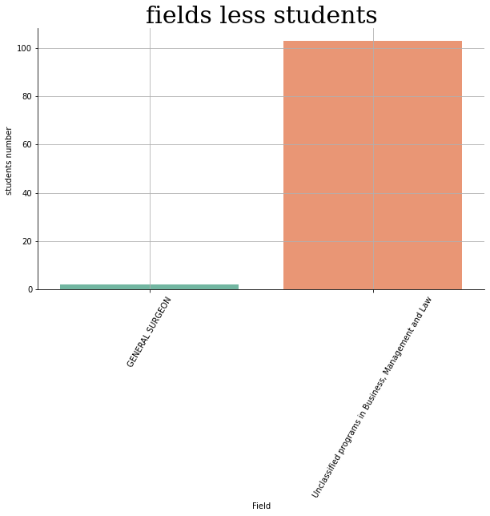

Slide 13
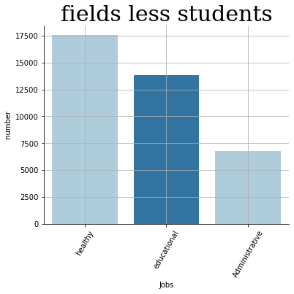
Jobs in KSA 2017

Slide 14
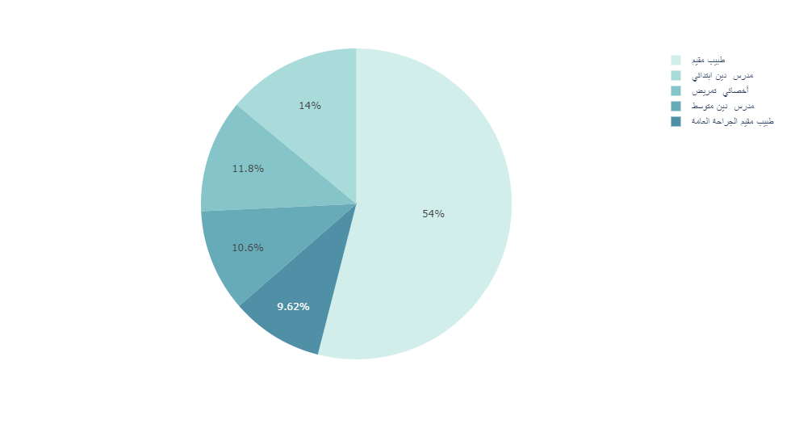
Jobs in KSA 2017
Fields most jobs

Slide 15
CONCLUSIONS
This analysis is recommended annually between the Ministry of Education and the Ministry of Resources and Human Development to identify new jobs, equip human resources, keep pace with global development and contribute to the 2030 vision.
Focus on King Faisal University and develop new specialties

Slide 16

Thank you

